Slide 1
Structures
An encapsulation mechanism

Slide 2
Encapsulation via Structures
In ML, a structure is an encapsulation mechanism that restricts the visibility of entities (i.e., variables) declared within the structure.
A structure provides a mechanism for managing the name space of a program and for grouping related declarations.

Slide 3
Syntax
structureEncapsulation ::= “structure” id “=”
“struct”
declarationList
“end”

Slide 4
Example
structure Model =
struct
fun updateEnv(id, t, loc, (env,s)) =
((id,t,loc)::env,s);
fun getType(t, loc) = t;
val m0 = ([],[]);
end;

Slide 5
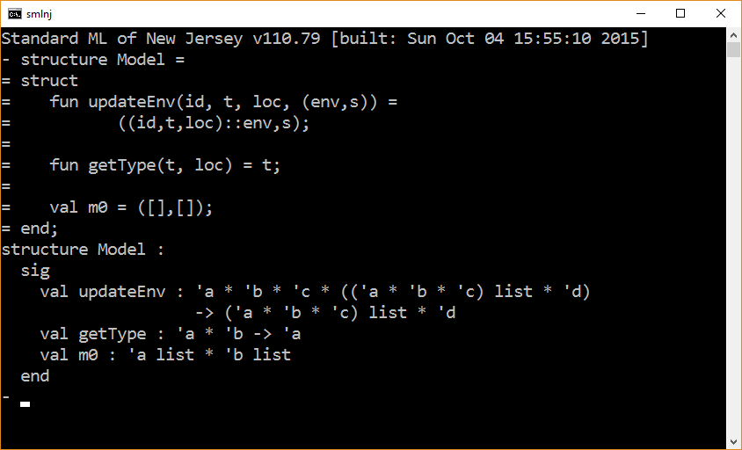

Slide 6
Accessing the elements in a structure
There are two ways to access an element declared in a structure:
Dot-notation. Type the name of the structure followed by a period followed by the name of the element (e.g., MyStruct.x).
Open Directive. Open the structure, using an open declaration in which case you can simply use the name of the element.
The open declaration can be viewed as a scope composition mechanism in which the present scope is extended with the declarations that are contained in the structure.

Slide 7
Dot-notation Example
structure Model =
struct
fun updateEnv( id,t,loc, (env,s) ) =
((id,t,loc)::env,s);
fun getType(t,loc) = t;
val m0 = ([],[]);
end;
val m0 = Model.m0;
val m1 = Model.updateEnv(“x”, “int”, 0, m0);

Slide 8
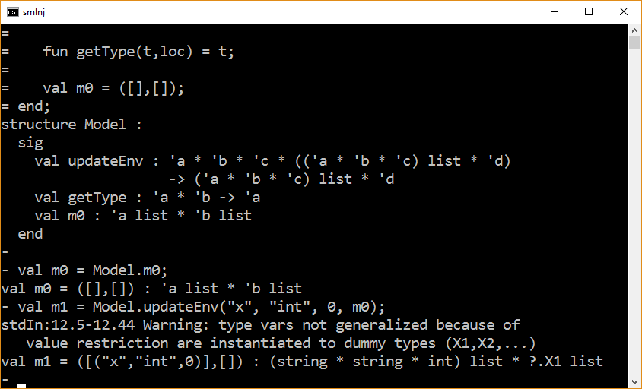

Slide 9
Open Delaration Example
structure Model =
struct
fun updateEnv( id,t,loc, (env,s) ) =
((id,t,loc)::env,s);
fun getType(t,loc) = t;
val m0 = ([],[]);
end;
open Model;
val m1 = updateEnv(“x”, “int”, 0, m0);

Slide 10
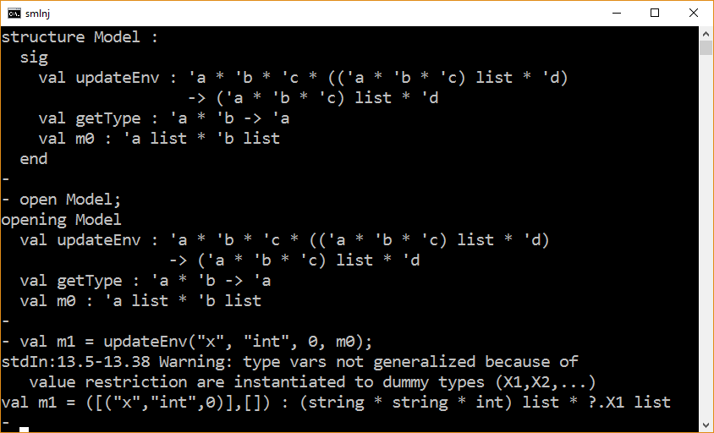

Slide 11
The End

